Slide 1
CST204 Database Management System
Module 1

Slide 2
Introduction
Syllabus – Overview
Module 1 : Introduction and Entity Relationship (ER) model
Module 2 : Relational Model
Module 3 : SQL DML and Physical Data Organization
Module 4 : Normalization
Module 5: Transaction, concurrency and recovery, recent topics

Slide 3
Introduction
Syllabus – Module 1
Concepts and Overview of Database Management System (DBMS)
Characteristics of Database System
Database Users
Structured, semi-structured and unstructured data
Data Models and Schema
Three Schema architecture
Database Languages
Database architectures and Classification
ER model
Basic concepts
entity set & attributes, Notations, Relationships and constraints, cardinality, Participation, Notations, weak entities, relationships of degree 3

Slide 4
Introduction to Databases
Database
Database is a collection of related data
Raw facts are called Data (data is plural, datum is singular)
Data means known facts that can be recorded and have implicit meaning
For example, the names, telephone numbers, and address of people can be recorded in an indexed address book
This collection of related data with an implicit meaning is a database

Slide 5
Introduction to Databases
Database
A database has the following properties:
A database represents some aspect of the real world, sometimes called the mini world or the universe of discourse (UoD)
A database is a logically coherent collection of data with some inherent meaning
A database is designed, built, and populated with data for a specific purpose

Slide 6
Introduction to Databases
Database
A database has some source from which the data is derived , some degree of interaction with events in the real world, and an audience that is actively interested in its contents
A database can be of any size and complexity
A database can be generated and maintained manually or it may be computerized
For example, a library card catalog is a database that may be created and maintained manually

Slide 7
Introduction to Databases
Database Management System (DBMS)
A computerized database may be created and maintained either by a group of application programs written specifically for that task or by a Database Management System (DBMS)
A database management system (DBMS) is a computerized system that enables users to create and maintain a database
The DBMS is a general-purpose software system that facilitates the processes of defining, constructing, manipulating, and sharing databases among various users and applications

Slide 8
Introduction to Databases
Database Management System (DBMS)
Defining a database involves specifying the data types, structures, and constraints of the data to be stored in the database
The database definition or descriptive information is also stored by the DBMS in the form of a database catalog or dictionary; it is called meta-data
Constructing the database is the process of storing the data on some storage medium that is controlled by the DBMS
Manipulating a database includes functions such as querying the database to retrieve specific data, updating the database to reflect changes in the miniworld, and generating reports from the data

Slide 9
Introduction to Databases
Database Management System (DBMS)
Sharing a database allows multiple users and programs to access the database simultaneously
An application program accesses the database by sending queries or requests for data to the DBMS
A query typically causes some data to be retrieved; a transaction may cause some data to be read and some data to be written into the database
Other important functions provided by the DBMS include protecting the database and maintaining it over a long period of time
Protection includes system protection against hardware or software malfunction (or crashes) and security protection against unauthorized or malicious access

Slide 10
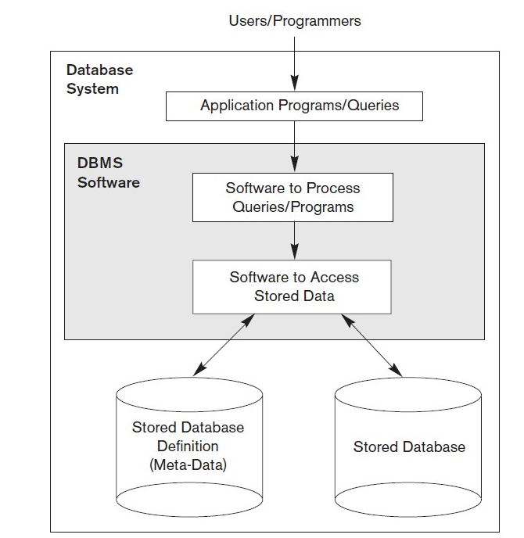
Introduction to Databases
Database Management System (DBMS) - Example
A university database for maintaining information concerning students, courses, and grades in a university environment

Slide 11
Introduction to Databases
Database Management System (DBMS) - Example
The database is organized as five files, each of which stores data records of the same type
The STUDENT file stores data on each student
The COURSE file stores data on each course
The SECTION file stores data on each section of a course
The GRADE_REPORT file stores the grades that students receive in the various sections they have completed
The PREREQUISITE file stores the prerequisites of each course

Slide 12
Introduction to Databases
Database Management System (DBMS) - Example
To define this database, we must specify the structure of the records of each file by specifying the different types of data elements to be stored in each record
Each STUDENT record includes data to represent the student’s Name, Student_number, Class, and Major (such as mathematics or ‘MATH’ and computer science or ‘CS’)
Each COURSE record includes data to represent the Course_name, Course_number, Credit_hours, and Department (the department that offers the course), and so on

Slide 13
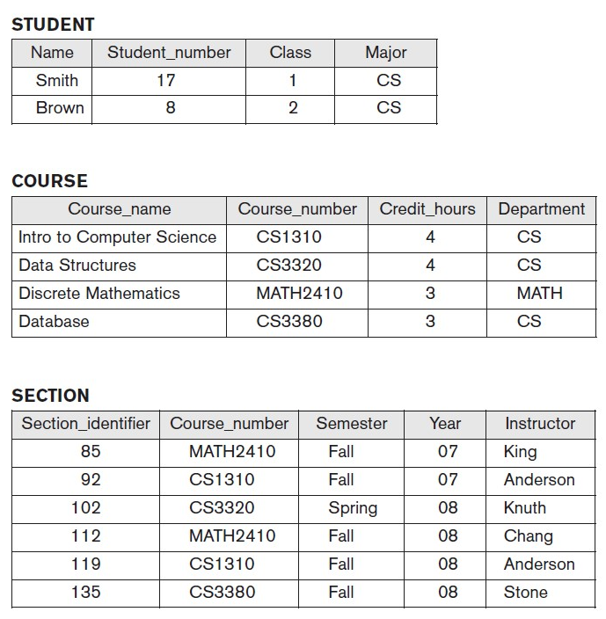
Introduction to Databases
Database Management System (DBMS) - Example

Slide 14
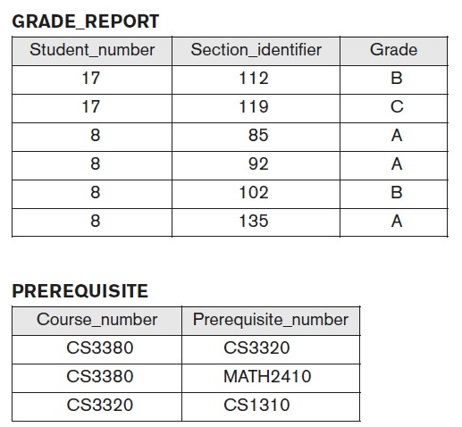
Introduction to Databases
Database Management System (DBMS) - Example

Slide 15
Introduction to Databases
Database Management System (DBMS) - Example
We must also specify a data type for each data element within a record
For example, we can specify that Name of STUDENT is a string of alphabetic characters, Student_number of STUDENT is an integer, and Grade of GRADE_REPORT is a single character from the set {‘A’, ‘B’, ‘C’, ‘D’, ‘F’, ‘I’}
We may also use a coding scheme to represent the values of a data item
For example, we represent the Class of a STUDENT as 1 for freshman, 2 for sophomore, 3 for junior, 4 for senior, and 5 for graduate student

Slide 16
Introduction to Databases
Database Management System (DBMS) - Example
To construct the UNIVERSITY database, we store data to represent each student, course, section, grade report, and prerequisite as a record in the appropriate file
Notice that records in the various files may be related
For example, the record for Smith in the STUDENT file is related to two records in the GRADE_REPORT file that specify Smith’s grades in two sections
Similarly, each record in the PREREQUISITE file relates two course records: one representing the course and the other representing the prerequisite
Most medium-size and large databases include many types of records and have many relationships among the records

Slide 17
Introduction to Databases
Database Management System (DBMS) - Example
Database manipulation involves querying and updating
Examples of queries are as follows:
Retrieve the transcript—a list of all courses and grades—of ‘Smith’
List the names of students who took the section of the ‘Database’ course offered in fall 2008 and their grades in that section
List the prerequisites of the ‘Database’ course
Examples of updates include the following:
Change the class of ‘Smith’ to sophomore
Create a new section for the ‘Database’ course for this semester
Enter a grade of ‘A’ for ‘Smith’ in the ‘Database’ section of last semester

Slide 18
Introduction to Databases
Characteristics of Database System
In traditional file processing, each user defines and implements the files needed for a specific software application as part of programming the application
Redundancy in defining and storing data results in wasted storage space and in redundant efforts to maintain common up to date data
In the database approach, a single repository maintains the data that is defined once and then accessed by various users

Slide 19
Introduction to Databases
Characteristics of Database System
The main characteristics of database approach versus the file processing approach is as follows:
The self describing nature of database system
Insulation between programs and data, and data abstraction
Support of multiple views of the data
Sharing of data and multiuser transaction processing
The self describing nature of database system
A fundamental characteristic of the database approach is that the database system contains not only the database itself but also a complete definition or description of the database structure and constraints

Slide 20
Introduction to Databases
Characteristics of Database System
The self describing nature of database system
This definition is stored in the DBMS catalog, which contains information such as the structure of each file, the type and storage format of each data item, and various constraints on the data
The information stored in the catalog is called meta-data, and it describes the structure of the primary database
The DBMS catalog will store the definitions of all the files in the University database

Slide 21
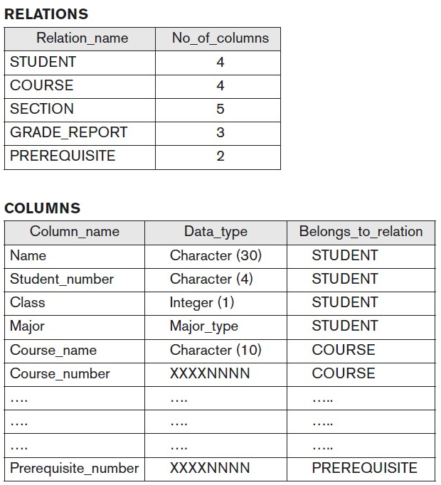
Introduction to Databases
Characteristics of Database System
The self describing nature of database system

Slide 22
Introduction to Databases
Characteristics of Database System
The self describing nature of database system
Whenever a request is made to access, say, the Name of a STUDENT record, the DBMS software refers to the catalog to determine the structure of the STUDENT file and the position and size of the Name data item within a STUDENT record
By contrast, in a typical file-processing application, the file structure and, in the extreme case, the exact location of Name within a STUDENT record are already coded within each program that accesses this data item

Slide 23
Introduction to Databases
Characteristics of Database System
Insulation between programs and data, and data abstraction
In traditional file processing, the structure of data files is embedded in the application programs, so any changes to the structure of a file may require changing all programs that access that file
DBMS access programs do not require such changes in most cases
The structure of data files is stored in the DBMS catalog separately from the access programs
We call this property program-data independence

Slide 24
Introduction to Databases
Characteristics of Database System
Insulation between programs and data, and data abstraction
For example, a file access program may be written in such a way that it can access only STUDENT records
If we want to add another piece of data to each STUDENT record, say the Birth_date, such a program will no longer work and must be changed
By contrast, in a DBMS environment, we only need to change the description of STUDENT records in the catalog to reflect the inclusion of the new data item Birth_date; no programs are changed
The next time a DBMS program refers to the catalog, the new structure of STUDENT records will be accessed and used

Slide 25
Introduction to Databases
Characteristics of Database System
Insulation between programs and data, and data abstraction
An operation (also called a function or method) is specified in two parts
The interface (or signature) of an operation includes the operation name and the data types of its arguments (or parameters)
The implementation (or method) of the operation is specified separately and can be changed without affecting the interface
User application programs can operate on the data by invoking these operations through their names and arguments, regardless of how the operations are implemented
This may be termed program-operation independence

Slide 26
Introduction to Databases
Characteristics of Database System
Insulation between programs and data, and data abstraction
The characteristic that allows program data independence and program operation independence is called data abstraction
A data model is a type of data abstraction that is used to provide conceptual representation
A DBMS provides users with a conceptual representation of data that does not include many of the details of how the data is stored or how the operations are implemented
The data model hides storage and implementation details that are not of interest to most database users

Slide 27
Introduction to Databases
Characteristics of Database System
Support of multiple views of data
A database has many users, each user may require a different perspective or view of the database
A view may be a subset of the database or it may contain virtual data that is derived from the database file but is not explicitly stored
A multiuser DBMS whose users have a variety of distinct applications must provide facilities for defining multiple views

Slide 28
Introduction to Databases
Characteristics of Database System
Sharing of data and multiuser transaction processing
A multiuser DBMS must allow multiple users to access the database at the same time
This is essential if data for multiple applications is to be integrated and maintained in a single database
The DBMS must include concurrency control software to ensure that several users trying to update the same data do so in a controlled manner so that the result of the updates are correct

Slide 29
Introduction to Databases
Characteristics of Database System
Sharing of data and multiuser transaction processing
A fundamental role of multiuser DBMS software is to ensure that concurrent transactions operate correctly and efficiently
A transaction is an executing program or process that includes one or more database accesses, such as reading or updating database records
Each transaction is supposed to execute a logically correct database access if executed in its entirety without interference from other transactions

Slide 30
Introduction to Databases
Database Users
Many people are involved in the design, use and maintenance of database
Major database users are
Database Administrators
Database Designers
End Users
System Analysts and Application Programmers (Software Engineers)

Slide 31
Introduction to Databases
Database Users
Database Administrator
When many people use the same resources, there is a need for a chief administrator to oversee and manage these resources
In a database environment, the primary resource is the database itself, and the secondary resource is the DBMS and related software
Administering these resources is the responsibility of the database administrator (DBA)
DBA is responsible for authorizing access to the database, coordinating and monitoring its use, and acquiring software and hardware resources as needed
DBA is accountable for problems such as security breaches and poor system response time
In large organization, the DBA is assisted by a staff that carries out these function

Slide 32
Introduction to Databases
Database Users
Database Designers
They are responsible for identifying the data to be stored in the database and for choosing appropriate structures to represent and store the data
These tasks are mostly undertaken before the database is actually implemented and populated with data
It is the responsibility of database designers to communicate with all prospective database users in order to understand their requirements and to create a design that meets these requirements
In many cases the designers are on the staff of DBA and may be assigned other staff responsibilities after the database design is completed
Database designers typically interact with each potential group of users and develop views of the database that meet the data and processing requirements of these group
Each view is then analyzed and integrated with the views of other user groups
The final database design must be capable of supporting the requirements of all user groups

Slide 33
Introduction to Databases
Database Users
End Users
End Users are the people whose jobs require access to the database for querying, updating, and generating reports
There are several categories of end users
Casual end users: they occasionally access the database, but they may need different information each time
They use a sophisticated database query language to specify their requests and are typically middle or high level managers or other occasional browsers
Naïve or parametric end users: they make up a sizable portion of database end users
Their main job function revolves around constantly querying and updating database, using standard types of queries and updates – called canned transactions – that have been carefully programmed and tested
Bank tellers check account balances and post withdrawals and deposits

Slide 34
Introduction to Databases
Database Users
End Users
Reservation agents for airlines, hotels, and car rental companies check availability for a given request and make reservations
Sophisticated end users: include engineers, scientists, business analyst, and others who thoroughly familiarize themselves with the facilities of the DBMS in order to implement their own applications to meet their complex requirements
Standalone users: maintain personal databases using ready-made program packages that provide easy-to-use menu based or graphics based interfaces
An example is the user of a tax package that stores a variety of personal financial data for tax purpose

Slide 35
Introduction to Databases
Database Users
System Analysts and Application Programmers (Software Engineers)
System Analysts determine the requirements of end users, especially naïve and parametric end users, and develop specifications for standard canned transaction that meet these requirements
Application programmers implement these specifications as programs then they test, debug, document, and maintain these canned transactions
Such analyst and programmers commonly referred to as software developers or software engineers should be familiar with the full range of capabilities provided by the DBMS to accomplish their tasks

Slide 36
Introduction to Databases
Database Users
Other Users
In addition to those who design, use and administer a database, others are associated with the design, development, and operation of DBMS software and system environment
They include
DBMS system designers and implementers
Tool developers
Operators and maintenance personnel

Slide 37
Introduction to Databases
Database Users
DBMS system designers and implementers
They design and implement the DBMS modules and interfaces as a software package
A DBMS is a very complex software system that consists of many components, or modules, including modules for implementing the catalog, query language processing, interface processing, accessing and buffering data, controlling concurrency and handling data recovery and security
The DBMS must interface with other system software such as the operating system and compilers for various programming languages

Slide 38
Introduction to Databases
Database Users
Tool developers
They design and implement tools – the software packages that facilitate database modelling and design, database system design, and improved performance
Tools are optional packages that are often purchased separately
They include packages for database design, performance monitoring, natural language or graphical interfaces, prototyping, simulations, and test data generations
In many cases, independent software vendors develop and market these tools

Slide 39
Introduction to Databases
Database Users
Operators and maintenance personnel
They are responsible for the actual running and maintenance of the hardware and software environment for database system
Although these categories of users are instrumental in making the database system available to end users, they typically do not use the database contents for their own purposes

Slide 40
Introduction to Databases
Structured, Semi-structured and unstructured data
There are three forms of data that are relavant for all kinds of business applications
Structured data
Structured data is generally tabular data that is represented by columns and rows in a database
Databases that hold tables in this form are called relational databases
The mathematical term “relation” specify to a formed set of data held as a table
In structured data, all row in a table has the same set of columns
SQL (Structured Query Language) programming language used for structured data

Slide 41
Introduction to Databases
Structured, Semi-structured and unstructured data
Semi-Structured data
Semi-structured data is information that doesn’t consist of Structured data (relational database) but still has some structure to it
Unstructured data
Unstructured data is information that either does not organize in a pre-defined manner or not have a pre-defined data model
Unstructured information is a set of text-heavy but may contain data such as numbers, dates, and facts as well
Videos, audio, and binary data files might not have a specific structure
They’re assigned to as unstructured data

Slide 42
Introduction to Databases
Data models, and schemas
Data models
Data abstraction generally refers to the suppression of details of data organization and storage, and the highlighting of the essential features for an improved understanding of data
A data model is a collection of concepts that can be used to describe the structure of a database and provides necessary means to achieve the abstraction
Structure of a database means the data types, relationships and constrains that apply to the data
Most data models include a set of operations for specifying retrievals and updates on the database

Slide 43
Introduction to Databases
Data models, and schemas
Categories of Data models
Many data models have been proposed which can be categorized according to the types of concepts they use to describe the database structure
High Level conceptual data models provide concepts that are close to the way many users perceive data
Low level or physical data models provide concepts that describe the details of how data is stored on the computer storage media generally meant for computer specialists not for end users
Representational or implementation data models provide concepts that may be easily understood by end users but that are not far from the physical data model

Slide 44
Introduction to Databases
Data models, and schemas
Categories of Data models
Conceptual data models use concepts such as entities, attributes and relationships
An entity represents a real world object or concept such as employee
An attribute represents some property of interest that further describes the entity such as name of the employee
A relationship among two or more entities represents the association among the entities such as a works on relationship between an employee and a project
An Entity Relationship model is an example of high level conceptual data model

Slide 45
Introduction to Databases
Data models, and schemas
Categories of Data models
Relational data model, network and hierarchical model are examples of Representational or implementational data model
Representational data models represent data by using record structures and hence are sometimes called Record based data models
Object data model is an example of a new family of higher level implementational data models that are closer to high level conceptual data model

Slide 46
Introduction to Databases
Data models, and schemas
Schemas
The description of database is called database schema
Schema is specified during database design and is not expected to change frequently
Most data models have certain conventions for displaying schemas as diagrams
A displayed schema is called schema diagram
A typical schema diagram for university database is shown below:

Slide 47
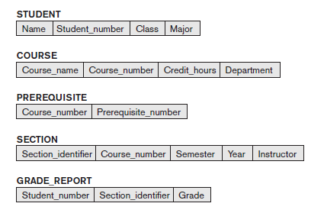
Introduction to Databases
Data models, and schemas
Schemas

Slide 48
Introduction to Databases
Data models, and schemas
Schemas
The schema diagram displays the structure of each record type but not the actual instances of the record
A schema diagram displays only some aspects of a schema such as name of record types and data items, and some types of constraints
Other aspects are not specified in the schema diagram
The actual data in a database may change quite frequently
The data in the database at a particular moment in time is called a database state or snapshot
It is also called the current set of occurrences or instances in database

Slide 49
Introduction to Databases
Data models, and schemas
Schemas
When we define a new database we specify its schema only to the DBMS
At this point, the corresponding database state is the empty state with no data
We get the initial state of the database when the database is first populated with initial data
DBMS stores the schema description in the meta data of DBMS catalog so that it can be referred whenever needed
The schema is sometimes called the intension and a database state is called an extension of the schema

Slide 50
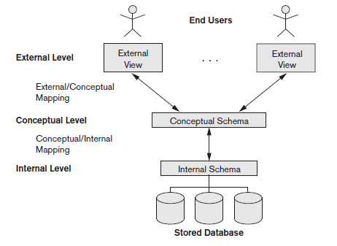
Introduction to Databases
Data models, and schemas
Three Schema Architecture
The goal of three schema architecture is to separate the user application from the physical database

Slide 51
Introduction to Databases
Data models, and schemas
Three Schema Architecture
In this architecture, schemas can be defined at the following three levels:
Internal Level has an internal schema, which describes the physical storage structure of the database
Internal schema uses a physical data model and describes the complete details of data storage and access path for the database
Conceptual level has a conceptual schema which describes the structure of the whole database for a community of users
It hides the details of physical storage structures and concentrates on describing entities, data types, relationships, user operations, and constraints

Slide 52
Introduction to Databases
Data models, and schemas
Three Schema Architecture
Usually a representational data model is used to describe the conceptual schema when a database system is implemented
Programmers and database administrators work at this level
The external level or view level includes a number of external schemas or user views
Each external schema describes the part of the database that a particular user group is interested in and hides the rest of the database from the user group
As in the previous level, each external schema is typically implemented using a representational data model

Slide 53
Introduction to Databases
Data models, and schemas
Three Schema Architecture
The external schema describes the end user interaction with database systems
Three schema architecture is a convenient tool with which the user can visualize the schema level in a database system
Mapping is used to transform the request and response between various database levels of architecture
In External / Conceptual mapping, it is necessary to transform the request from external level to conceptual schema
In Conceptual / Internal mapping, DBMS transform the request from the conceptual to internal level

Slide 54
Introduction to Databases
Data models, and schemas
Three Schema Architecture – Data Independence
Data independence is the capacity to change the schema at one level of a database system without having to change the schema at the next higher level
Two types of data independence – logical data independence, physical data independence
Logical data independence is the capacity to change the conceptual schema without having to change external schemas or application programs
We may change the conceptual schema to expand the database by adding a record type or data items, to change constraints, or to reduce the database by removing a record type or data item

Slide 55
Introduction to Databases
Data models, and schemas
Three Schema Architecture – Data Independence
Physical data independence is the capacity to change the internal schema without having to change the conceptual schema
Hence the external schemas need not be changed as well
Changes to internal schema may needed because some physical files were reorganized to improve the performance of retrieval or update
Whenever we have a multiple level DBMS, its catalog must be expanded to include information on how to map requests and data among the various levels
The DBMS uses additional software to accomplish these mappings by referring to mapping information in the catalog

Slide 56
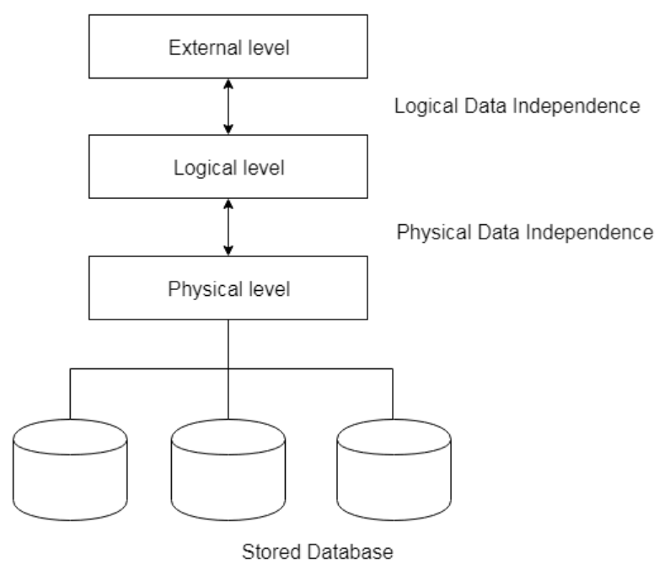
Introduction to Databases
Data models, and schemas
Three Schema Architecture – Data Independence
Data independence occurs because when the schema is changed at some level, the schema at next higher level remains unchanged; only mapping between the two levels is changed

Slide 57
Introduction to Databases
Database languages
Once the design of a database is completed and a DBMS is chosen to implement database, the first step is to specify conceptual and internal schema for the database and any mapping between the two
In many DBMSs where no strict separation of levels is maintained, one language, called Data Definition Language (DDL) is used by the DBA and by database designers to define both schemas
In many DBMSs where a clear separation of levels is maintained, DDL is used to specify the conceptual schema only; another language called Storage Definition Language (SDL) is used to specify internal schema
There is no specific language that performs the role of SDL

Slide 58
Introduction to Databases
Database languages
View Definition Language (VDL) is used to specify user views and their mappings to the conceptual schema but in most DBMSs the DDL is used to define both conceptual and external schema
Once the database schema is completed and the database is populated with data we use Data Manipulation Language (DML) to manipulate the database – retrieval, insertion, deletion and modification of data
Data Control Language (DCL) is used to retrieve the stored or saved data from the database
Transaction Control Language (TCL) is used to run the changes made by the DML statement
In current DBMSs the above mentioned languages are usually not considered distinct languages; rather a comprehensive integrated language is used – Structured Query Language (SQL)

Slide 59
Introduction to Databases
Database languages
SQL represents a combination of DDL, VDL, DML, TCL and DCL
SQL can execute queries against a database
SQL can retrieve data from a database
SQL can insert records in a database
SQL can update records in a database
SQL can delete records from a database
SQL can create new databases
SQL can create new tables in a database
SQL can create stored procedures in a database
SQL can create views in a database
SQL can set permissions on tables, procedures, and views

Slide 60
Introduction to Databases
Database Architectures
Architectures for database can be classified into two – Centralized DBMS Architecture (single tier) and Client – Server Architecture (Multi tier)
Centralized DBMS architecture
In this architecture, the database is directly available to the user
It means the user can directly sit on the DBMS and uses it
Any changes done here will directly be done on the database itself
It doesn't provide a handy tool for end users
The 1-Tier architecture is used for development of the local application, where programmers can directly communicate with the database for the quick response

Slide 61
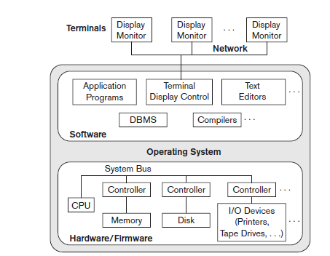
Introduction to Databases
Database Architectures
Centralized DBMS architecture

Slide 62
Introduction to Databases
Database Architectures
Client – Server architecture
The idea is to define specialized servers with specific functionalities
For example a machine designated as printer server by being connected to various printers; all print requests by the client are forwarded to this machine
The client machines provide the user with appropriate interfaces to utilize these servers as well as with local processing powers to run local applications
A client is typically a user machine that provides user interface capabilities and local processing
A server is a system containing both hardware and software that can provide services to the client machines such as file access, printing, archiving or database access

Slide 63
Introduction to Databases
Database Architectures
Client – Server architecture
Two main types of this category of architecture is two tier and three tier
Two Tier Client – Server Architecture
The user interface and application program runs on the client side
When DBMS access is required the program establishes a connection to the DBMS (which is on the server side)
Once the connection is created, the client program can communicate with the DBMS
A standard called Open Database Connectivity (ODBC) provides an application programming interface (API), which allows client-side programs to call the DBMS

Slide 64
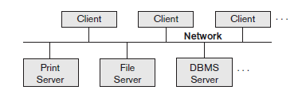
Introduction to Databases
Database Architectures
Client – Server architecture
Two Tier Client – Server Architecture

Slide 65
Introduction to Databases
Database Architectures
Client – Server architecture
Two Tier Client – Server Architecture
The architecture is called two-tier architectures because the software components are distributed over two systems: client and server
The advantages of this architecture are its simplicity and seamless compatibility with existing systems
Three Tier Client – Server Architecture
Many Web applications use an architecture called the three-tier architecture, which adds an intermediate layer between the client and the database server

Slide 66
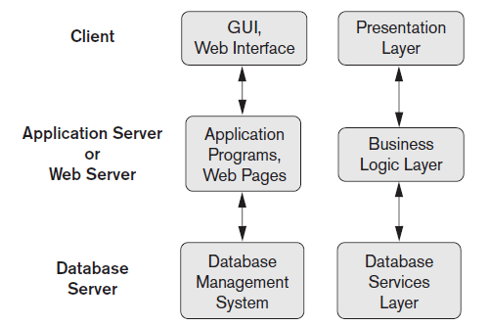
Introduction to Databases
Database Architectures
Client – Server architecture
Three Tier Client – Server Architecture

Slide 67
Introduction to Databases
Database Architectures
Client – Server architecture
Three Tier Client – Server Architecture
The intermediate layer or middle tier is called the application server or the Web server, depending on the application
This server plays an intermediary role by running application programs and storing business rules (procedures or constraints) that are used to access data from the database server
It can also improve database security by checking a client’s credentials before forwarding a request to the database server
Clients contain user interfaces and Web browsers

Slide 68
Introduction to Databases
Database Architectures
Client – Server architecture
Three Tier Client – Server Architecture
The intermediate server accepts requests from the client, processes the request and sends database queries and commands to the database server, and then acts as a conduit for passing (partially) processed data from the database server to the clients, where it may be processed further and filtered to be presented to the users
Thus, the user interface, application rules, and data access act as the three tiers
In another way, the presentation layer displays information to the user and allows data entry
The business logic layer handles intermediate rules and constraints before data is passed up to the user or down to the DBMS
The bottom layer includes all data management services

Slide 69
Introduction to Databases
DBMS Classification
The major criteria used to classify DBMS are
Data model on which the DBMS is based
Number of users supported by the system
Number of sites over which the database is distributed
Cost
Purpose
Data model on which the DBMS is based
Based on the data model we have:
Relational DBMS (RDBMS):
Relational data model represents a database as a collection of tables, where each table can be stored as a separate file
Most relational databases use the high-level query language called SQL

Slide 70
Introduction to Databases
DBMS Classification
Data model on which the DBMS is based
Object DBMS (ODBMS):
Object data model defines database in terms of objects, their properties, and their operations
Objects with the same structure and behavior belong to a class, and classes are organized into hierarchies
The operations of each class are specified in terms of predefined procedures called methods
Big Data DBMS:
Big data systems are based on various data models, with the following four data models most common

Slide 71
Introduction to Databases
DBMS Classification
Data model on which the DBMS is based
Big Data DBMS:
The key-value data model associates a unique key with each value (which can be a record or object) and provides very fast access to a value given its key
The document data model is based on JSON (Java Script Object Notation) and stores the data as documents, which somewhat resemble complex objects
The graph data model stores objects as graph nodes and relationships among objects as directed graph edges
The column-based data models store the columns of rows clustered on disk pages for fast access and allow multiple versions of the data

Slide 72
Introduction to Databases
DBMS Classification
Data model on which the DBMS is based
XML model based DBMS
This model has emerged as a standard for exchanging data over the Web and has been used as a basis for implementing several prototype native XML systems
XML uses hierarchical tree structures
It combines database concepts with concepts from document representation models
Data is represented as elements; with the use of tags, data can be nested to create complex tree structures
This model conceptually resembles the object model but uses different terminology

Slide 73
Introduction to Databases
DBMS Classification
Data model on which the DBMS is based
Network model based DBMS
The network model represents data as record types and also represents a limited type of 1:N relationship, called a set type
A 1:N, or one-to-many, relationship relates one instance of a record to many record instances using some pointer linking mechanism in these models
Hierarchical model based DBMS
The hierarchical model represents data as hierarchical tree structures. Each hierarchy represents a number of related records
There is no standard language for the hierarchical model

Slide 74
Introduction to Databases
DBMS Classification
Number of users supported by the system
Single-user systems
Support only one user at a time and are mostly used with PCs
Multiuser systems
Include the majority of DBMSs, support concurrent multiple users
Number of sites over which the database is distributed
Centralized DBMS
If the data is stored at a single computer site
A centralized DBMS can support multiple users, but the DBMS and the database reside totally at a single computer site
Distributed DBMS (DDBMS)
Can have the actual database and DBMS software distributed over many sites connected by a computer network

Slide 75
Introduction to Databases
DBMS Classification
Cost
Paid and free DBMS
Purpose
General Purpose DBMS
When performance is not a prime concern general propose DBMS is used
Special Purpose DBMS
When performance is a primary consideration, a special-purpose DBMS can be designed and built for a specific application
Such a system cannot be used for other applications without major changes

Slide 76
Entity Relationship (ER) Model
Database Design Process
Requirement collection and analysis – Database designers collect all requirements from database users
Conceptual Design – Designing conceptual schema using high level conceptual model like E R Model
Logical Design – Using SQL conceptual schema is converted in to actual implementation data model
Physical Design – Internal storage structures, file organizations, indexes for database files are specified
The above steps are phases in database design much like phases in software engineering
E R model comes in the second step – Conceptual Design

Slide 77
Entity Relationship (ER) Model
Entity
Thing or object in the real world with an independent existence
An entity may be an object with a physical existence eg: person, car, house, or employee
An entity may be an object with a conceptual existence eg: a company, a job, or a university course
Attribute
Each entity has attributes—the particular properties that describe it
For example, an EMPLOYEE entity may be described by the employee’s name, age, address, salary, and job
An entity will have a value for each of its attributes
The attribute values that describe each entity become a major part of the data stored in the database

Slide 78
Entity Relationship (ER) Model
Example
The EMPLOYEE entity e1 has four attributes: Name, Address, Age, and Home_phone
Their values are ‘John Smith,’ ‘2311 Kirby, Houston, Texas 77001’, ‘55’, and ‘713-749-2630’, respectively.
The COMPANY entity c1 has three attributes: Name, Headquarters, and President
Their values are ‘Sunco Oil’, ‘Houston’, and ‘John Smith’, respectively
Several types of attributes occur in the ER model:
Simple versus composite
Single valued versus multivalued
Stored versus derived

Slide 79
Entity Relationship (ER) Model
Simple and Composite Attribute
Simple Attribute - Attributes that are not divisible are called simple or atomic attributes
Composite attributes - Attributes that can be divided into smaller subparts, which represent more basic attributes with independent meanings.
For example, the Address attribute of the EMPLOYEE entity shown can be subdivided into Street_address, City, State, and Zip,3 with the values ‘2311 Kirby’, ‘Houston’, ‘Texas’, and ‘77001’
Composite attributes can form a hierarchy; for example, Street_address can be further subdivided into three simple component attributes: Number, Street, and Apartment_number

Slide 80
Entity Relationship (ER) Model
Single and Multivalued Attribute
Single-valued Attribute: Attributes that have a single value for a particular entity
For example, Age is a single-valued attribute of a person
Multi-valued Attribute: An attribute can have a set of values for the same entity—for instance, a Colors attribute for a car, or a College_degrees attribute for a person
Cars with one color have a single value, whereas two-tone cars have two color values
Similarly, one person may not have any college degrees, another person may have one, and a third person may have two or more degrees

Slide 81
Entity Relationship (ER) Model
Stored and Derived Attribute
Derived Attributes: In some cases, two (or more) attribute values are related—for example, the Age and Birth_date attributes of a person
For a particular person entity, the value of Age can be determined from the current (today’s) date and the value of that person’s Birth_date
The Age attribute is hence called a derived attribute and is said to be derivable from the Birth_date attribute, and is represented in a dashed oval in ER Diagram
Stored Attribute: the Birth_date attribute is called a stored attribute
Some attribute values can be derived from related entities
For example, an attribute Number_of_employees of a DEPARTMENT entity can be derived by counting the number of employees related to (working for) that department

Slide 82
Entity Relationship (ER) Model
Null Attribute
In some cases, a particular entity may not have an applicable value for an attribute
For example, the Apartment_number attribute of an address applies only to addresses that are in apartment buildings and not to other types of residences, such as single-family homes
Similarly, a College_degrees attribute applies only to people with college degrees
For such situations, a special value called NULL is created
An address of a single-family home would have NULL for its Apartment_number attribute, and a person with no college degree would have NULL for College_degrees
NULL can also be used if we do not know the value of an attribute for a particular entity

Slide 83
Entity Relationship (ER) Model
Composite Attribute
In general, composite and multivalued attributes can be nested arbitrarily
We can represent arbitrary nesting by grouping components of a composite attribute between parentheses ( ) and separating the components with commas, and by displaying multivalued attributes between braces { }
Such attributes are called complex attributes
For example, if a person can have more than one residence and each residence can have a single address and multiple phones, an attribute Address_phone for a person can be specified as
{Address_phone({Phone(Area_code,Phone_number)},Address(Street_address(Number,Street,Apartment_number),City,State,Zip) )}

Slide 84
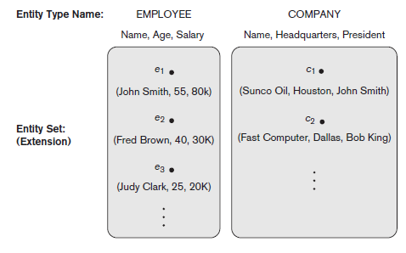
Entity Relationship (ER) Model
Entity types and Entity sets
A database usually contains groups of entities that are similar and collection of entities that have same attributes even though they have different values are called entity types
collection of all entities of a particular entity type in the database at any point in time is called entity set

Slide 85
Entity Relationship (ER) Model
Entity types and Entity sets
An entity type is represented in ER diagram as a rectangular box enclosing the entity type name
Attribute names are enclosed in ovals and are attached to their entity type by straight lines
Composite attributes are attached to their component attributes by straight lines
Multivalued attributes are displayed in double ovals
An entity type usually has one or more attributes whose values are distinct for each individual entity in the entity set
Such an attribute is called a key attribute, and its values can be used to identify each entity uniquely

Slide 86
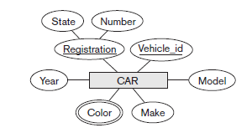
Entity Relationship (ER) Model
Entity types and Entity sets
For example, the Name attribute is a key of the COMPANY entity type in the figure above because no two companies are allowed to have the same name
For the PERSON entity type, a typical key attribute is Ssn (Social Security number)
In ER diagrammatic notation, each key attribute has its name underlined inside the oval
An entity type may also have no key, in which case it is called a weak entity type otherwise called strong entity type

Slide 87
Entity Relationship (ER) Model
Entity types and Entity sets
Each simple attribute of an entity type is associated with a value set (or domain of values), which specifies the set of values that may be assigned to that attribute for each individual entity
For example if the range of ages allowed for employees is between 16 and 70, we can specify the value set of the Age attribute of EMPLOYEE to be the set of integer numbers between 16 and 70
Value set for the Name attribute to be the set of strings of alphabetic characters separated by blank characters, and so on
Value sets are not typically displayed in basic ER diagrams and are similar to the basic data types available in most programming languages, such as integer, string, Boolean, float, enumerated type, subrange, and so on

Slide 88
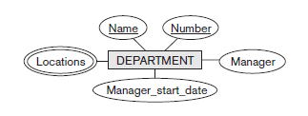
Entity Relationship (ER) Model
E R Diagram Examples
An entity type DEPARTMENT with attributes Name, Number, Locations, Manager, and Manager_start_date
Locations is the only multivalued attribute
We can specify that both Name and Number are (separate) key attributes because each was specified to be unique.

Slide 89
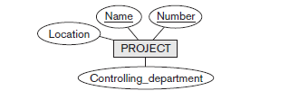
Entity Relationship (ER) Model
E R Diagram Examples
An entity type PROJECT with attributes Name, Number, Location, and Controlling_department
Both Name and Number are (separate) key attributes

Slide 90
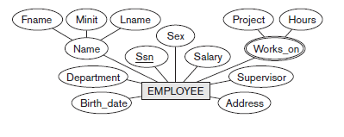
Entity Relationship (ER) Model
E R Diagram Examples
An entity type EMPLOYEE with attributes Name, Ssn, Sex, Address, Salary, Birth_date, Department, and Supervisor
Both Name and Address may be composite attributes; however, this was not specified in the requirements
We must go back to the users to see if any of them will refer to the individual components of Name—First_name, Middle_initial, Last_name—or of Address
In our example, Name is modeled as a composite attribute, whereas Address is not, presumably after consultation with the users

Slide 91

Entity Relationship (ER) Model
E R Diagram Examples
An entity type DEPENDENT with attributes Employee, Dependent_name, Sex, Birth_date, and Relationship (to the employee)

Slide 92
Entity Relationship (ER) Model
Relationship
A relationship relates two or more distinct entities with a specific meaning
For example, EMPLOYEE John Smith works on the ProductX PROJECT
EMPLOYEE Franklin Wong manages the Research DEPARTMENT
Relationship of the same type are grouped into a relationship type
A relationship type R among n entity types E₁, E₂, …,E_{n} defines a set of associations or a relationship set among entities from these entity types
More than one relationship type can exist with the same participating entity types
For example, MANAGES and WORKS_FOR are distinct relationships between EMPLOYEE and DEPARTMENT

Slide 93
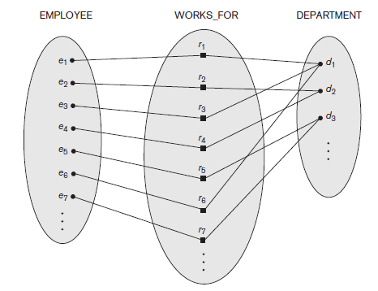
Entity Relationship (ER) Model
Relationship

Slide 94
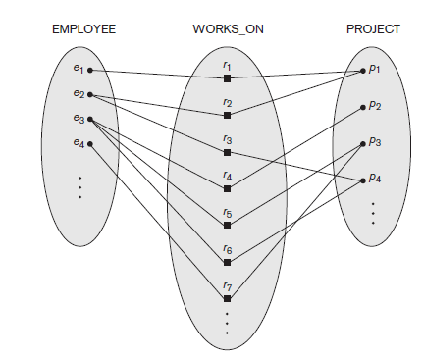
Entity Relationship (ER) Model
Relationship

Slide 95
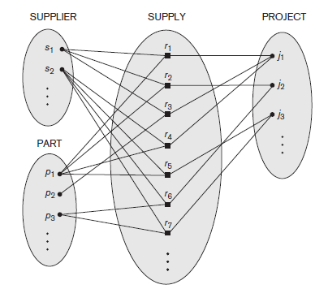
Entity Relationship (ER) Model
Relationship
Degree of a relationship type is the number of participating entity types
For example, WORKS_FOR relationship is of degree two
Relationship type of degree two is called binary relationship
Relationship type of degree three is called ternary relationship

Slide 96
Entity Relationship (ER) Model
Relationship
Role names signifies that role that a participating entity from the entity type plays in each relationship instance
It helps to explain what the relationship means
For example, WORKS_FOR relationship type, EMPLOYEE plays the role of employee or worker and DEPARTMENT plays the role of department or employer
In recursive relationship, both participations are same entity type in different roles
For examples, SUPERVISION relationships between EMPLOYEE (in role of supervisor or boss) and (another) EMPLOYEE (in role of subordinate or worker)

Slide 97
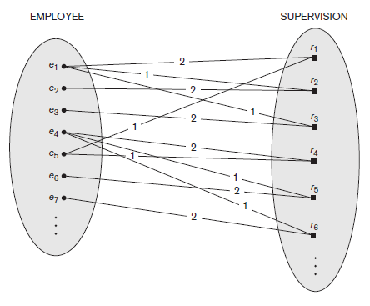
Entity Relationship (ER) Model
Relationship
1 – Supervisor
2 – Subordinate

Slide 98
Entity Relationship (ER) Model
Constraints on binary relationships
Relationship types usually have certain constraints that limit the possible combinations of entities that may participate in the corresponding relationship set
There are two major constraints:
Cardinality ratio
Participation
They are together called structural constraints
Cardinality ratio
It specifies the maximum number of relationship instances that an entity can participate in
For example, WORKS_FOR, DEPARTMENT: EMPLOYEE is of cardinality ratio 1: N

Slide 99
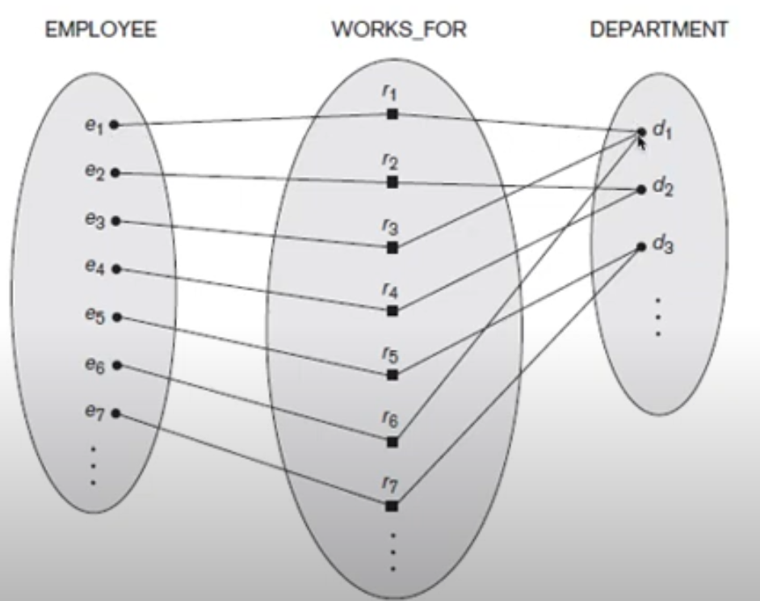
Entity Relationship (ER) Model
Constraints on binary relationships
Cardinality ratio (1 : N)

Slide 100
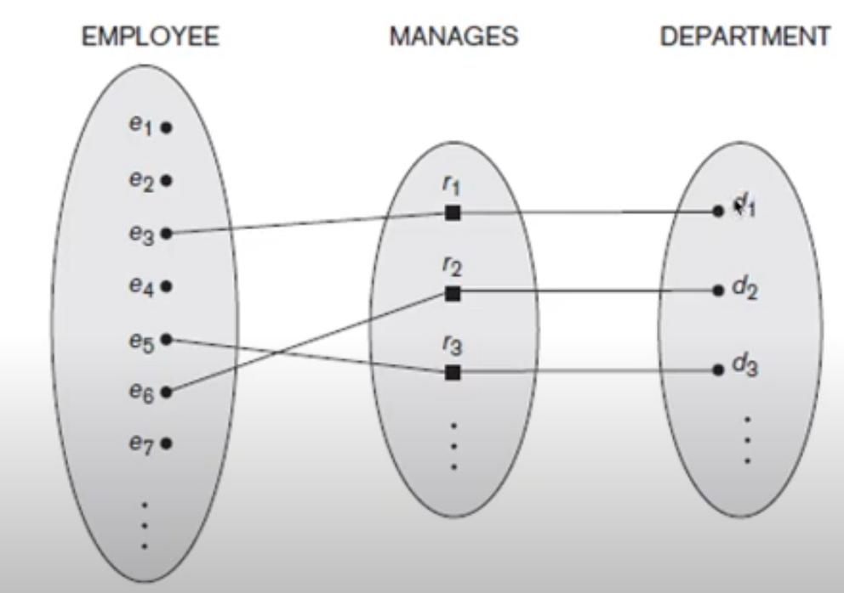
Entity Relationship (ER) Model
Constraints on binary relationships
Cardinality ratio (1 : 1)

Slide 101
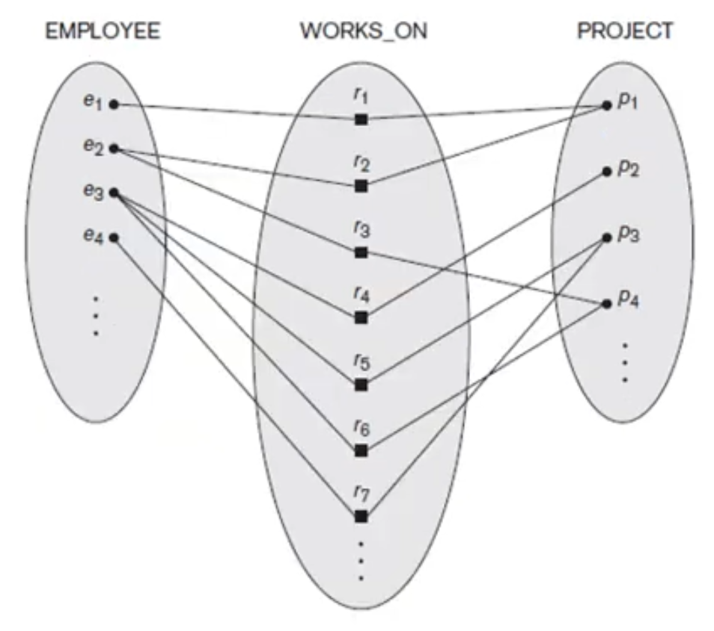
Entity Relationship (ER) Model
Constraints on binary relationships
Cardinality ratio (M : N)

Slide 102
Entity Relationship (ER) Model
Constraints on binary relationships
Participation Constraints
Specifies whether the existence of an entity depends on its being related to another entity
Specifies the minimum number of relationship instances that each entity can participate in
Also called the minimum cardinality constraints
There are two types of participation constraints – total and partial
Total participation
It is also called existence dependency
The WORKS_FOR relationship is of total participation that means every employee should work for any department which is mandatory

Slide 103
Entity Relationship (ER) Model
Constraints on binary relationships
Participation Constraints
Partial participation
The MANAGES relationship is of partial participation that means some employees can manage a department
Attributes of Relationship types
A relationship type can have attributes
For example, HoursPerWeek of WORKS_ON, means number of hours per week that an EMPLOYEE works on a PROJECT

Slide 104
Entity Relationship (ER) Model
Weak Entity Types
Entity that does not have a key attribute is called a weak entity type
Weak entity must participate in an identifying relationship type with an owner or identifying entity type
Entities are identified by the combination of:
A partial key of the weak entity type
Particular entity they are related to in the identifying entity type
For example, a DEPENDENT entity is identified by the dependent’s firstname and birthdate and the specific EMPLOYEE that the dependent is related to

Slide 105
Entity Relationship (ER) Model
Relationship
A relationship is represented by diamond shape in ER diagram, it shows the relationship among entities
There are four types of relationships:
One to One
One to Many
Many to One
Many to Many
One to One Relationship
When a single instance of an entity is associated with a single instance of another entity then it is called one to one relationship
For example, a person has only one passport and a passport is given to one person

Slide 106
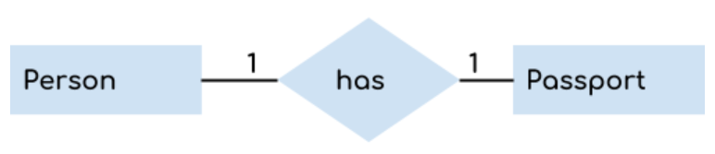
Entity Relationship (ER) Model
Relationship
One to One Relationship
One to Many Relationship
When a single instance of an entity is associated with more than one instances of another entity then it is called one to many relationship
For example – a customer can place many orders but a order cannot be placed by many customers

Slide 107
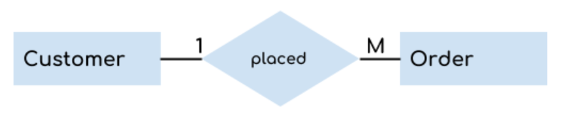
Entity Relationship (ER) Model
Relationship
One to Many Relationship
Many to One Relationship
When more than one instances of an entity is associated with a single instance of another entity then it is called many to one relationship
For example – many students can study in a single college but a student cannot study in many colleges at the same time

Slide 108

Entity Relationship (ER) Model
Relationship
Many to One Relationship
Many to Many Relationship
When more than one instances of an entity is associated with more than one instances of another entity then it is called many to many relationship
For example, a can be assigned to many projects and a project can be assigned to many students

Slide 109
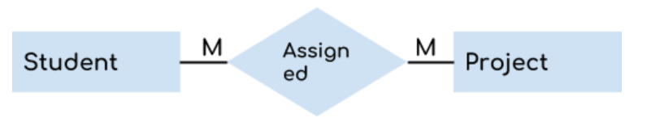
Entity Relationship (ER) Model
Relationship
Many to Many Relationship

Slide 110
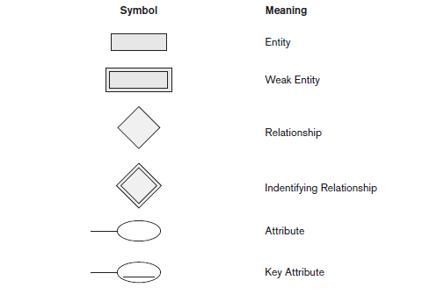
Entity Relationship (ER) Model
Notations

Slide 111
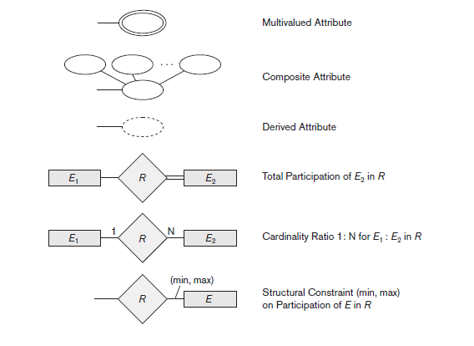
Entity Relationship (ER) Model
Notations

Slide 112
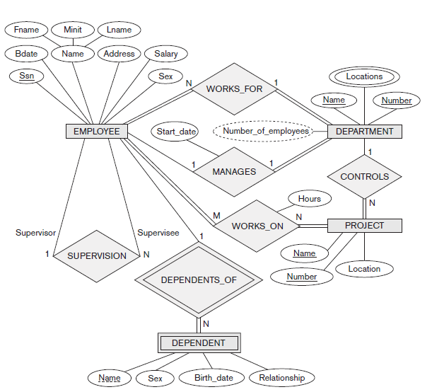
Entity Relationship (ER) Model
E R Diagram

Slide 113
Entity Relationship (ER) Model
E R Diagram
Min max notation
Specified on each participation of an entity type E in a relationship type R
Specifies that each entity e in E participates in at least min and at most max relationship instances of R
For example, a department has exactly one manager and an employee can manage at most one department
Specify (0,1) for participation of EMPLOYEE in MANAGES
Specify (1,1) for participation of DEPARTMENT in MANAGES

Slide 114
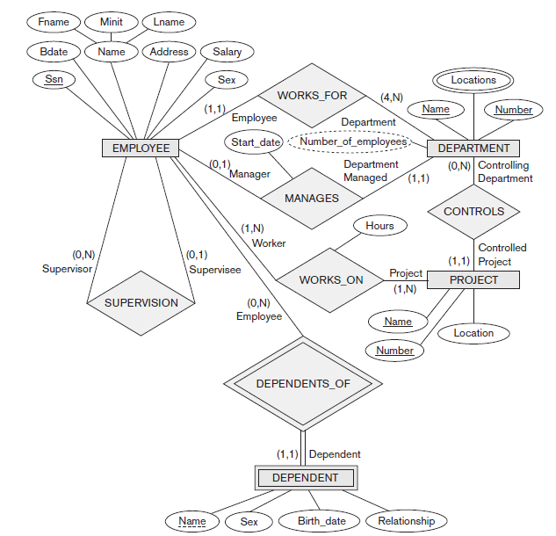
Entity Relationship (ER) Model
E R Diagram
Min max notation

